Slide 1
Machine Learning
Quiz 4

Slide 2
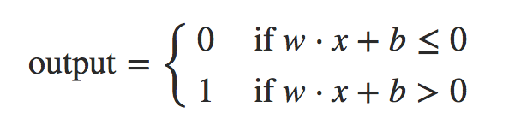
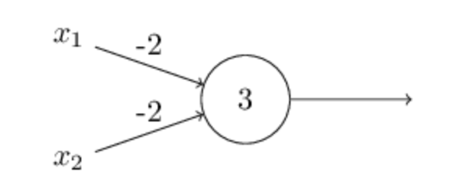
Question 1 (3 Points)
Consider the following perceptron having two inputs with each weight (-2) and a bias (3).
Write the perceptron rule
Use the perceptron rule to compute the output for the following inputs.
0, 0
0, 1
1, 0
1, 1
Use the calculated outputs to name the logical function which this perceptron implements.
Notes:
I have included it in the ”red” rectangle above. Students might write it in different ways, give them points if the representation is different but means the same thing. (1 Point)
1, 1, 1, 0 (1 Point)
NAND (1 Point)

Slide 3
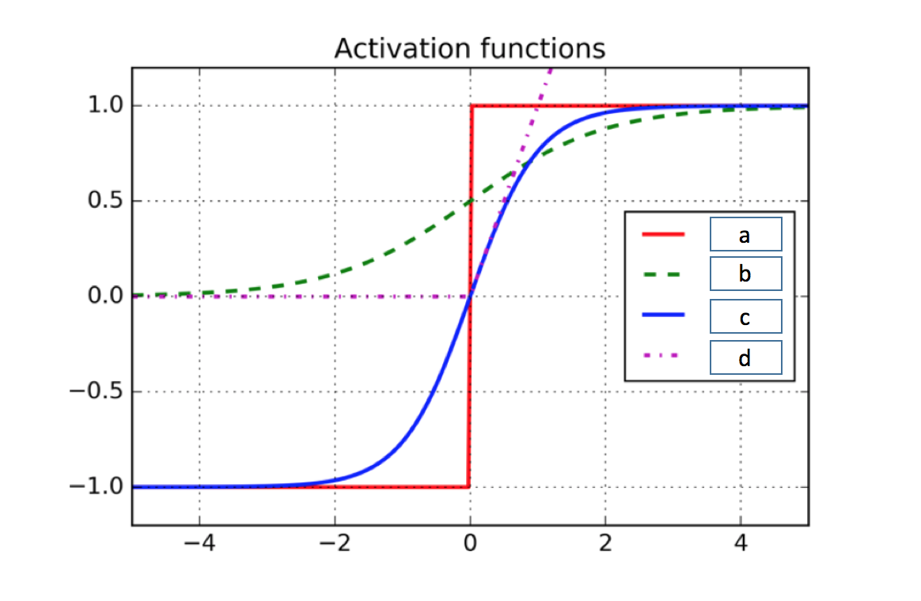
Question 2 (4 Points)
Name the activation functions
Notes:
Step function (1 Point)
Sigmoid (1 Point)
Tanh (1 Point)
ReLU (1 Point)

Slide 4
Question 3 (6 Points)
True or False
we can use networks of perceptrons to compute any logical function at all (Justify your choice)
In any ANN, the output of each neuron at the output layer always corresponds to the estimated probability of the corresponding class.
A neural network becomes a deep learning model when we increase the dimensionality of input data. (Justify your choice)
The number of neurons in the output layer should always match the number of classes in a supervised learning task
In terms of deep learning, an (image) convolution is an element-wise multiplication of two matrices followed by a sum.
Notes:
True (as shown earlier that a perceptron can be used to implement a NAND function, and since NAND gate is universal for computation, that is, we can build any computation up out of NAND gates) (1.5 Points)
False (1 Point)
False (depth is measured in terms of the number of layers in a network, not in terms of the dimensionality of the input) (1.5 Points)
False (1 Point)
True (1 Point)

Slide 5
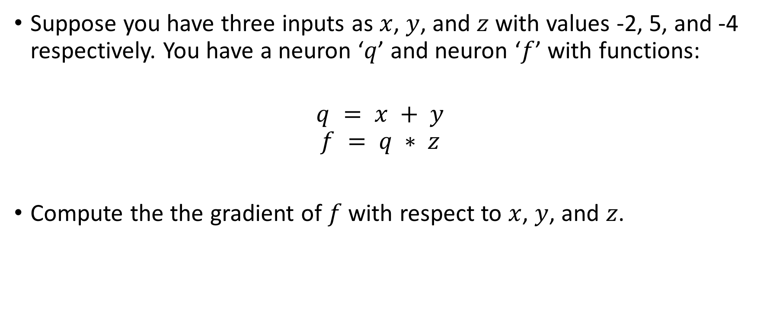
Question 4 (3 Points)
Suppose you have three inputs as $x$, $y$, and $z$ with values -2, 5, and -4 respectively. You have a neuron ‘$q$’ and neuron ‘$f$’ with functions:
$$q = x + y$$
$$f = q ∗ z$$
Compute the the gradient of $f$ with respect to $x$, $y$, and $z$.
Notes:
(-4, -4, 3)
Deduct 1.5 points If they did not compute and simply wrote the values, instead.

Slide 6
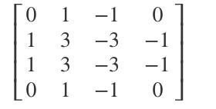
Question 5 (1 Point)
You know that we can convolve filters with images to detect important
What do you think applying this filter to a grayscale image will do?
Notes:
It will detect vertical edges. [Students might answer this question in various ways; mark their answers correct even if it is different but means the same thing]

Slide 7
Question 6 (3 Points)
Compute the size of the output in each case.
(A)
(B)
(C)
f = 3
s = 1
p = 0
10 filters
f = 5
s = 2
p = 0
20 filters
f = 3
s = 2
p = 0
40 filters
?
?
?
39 x 39 x 3
Notes:
37 x 37 x 10
17 x 17 x 20
8 x 8 x 40
Deduct 1.5 points If they did not compute and simply wrote the values, instead
Also, there was typo: p is the padding not the pooling size. I explained it to the students in my class. And I hope that you did the same.
Still, there could be some students who might have solved it considering p to be the pooling size. Therefore, mark this question carefully, and if such answers are correct, give them full points.

Slide 8
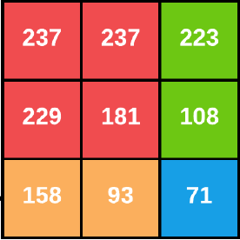
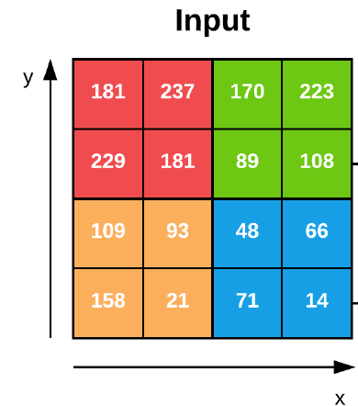


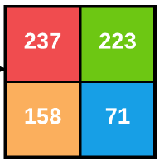
Question 7 (2 Points)
Give the output after applying the specified pooling operation
(A)
(B)
Notes:
(a) (1 Point)
(b) (1 Point)

